Slide 1




The Netflix Titles Data Set
This presentation explores the Netflix Titles data set, a rich source of information about movies and TV shows available on the streaming platform.
Goal
My goal is to derive insights from the data using mysql.
by benson wathigo

Slide 2
Importing the Data: Challenges and Insights
1
Data Acquisition
The first step was to acquire the Netflix title data set from netflix_titles, ensuring its accuracy and completeness.
2
Data Conversion
I converted the data from csv to microsoft excel for easy analysis.
3
Data Analysis
I came up with graphs using excel and saved the graphs as images using the screenshot method.
4
Pasting
I pasted the images here for the presentation.

Slide 3

Interesting thing I found
It is much easier to work on excel.
There are multiple methods for importing pictures. Determine what works, then take action.

Slide 4

Captivating Fact: The Most Common Rating is TV-MA
The TV-MA rating is the most common in the Netflix titles data set. This indicates that adult-oriented content is prevalent on the streaming platform. Many titles on Netflix target mature audiences.

Slide 5



Captivating Fact: Toshiya Shinoyara Has the Most Titles
Prolific Director
Extensive Catalog
Interesting thing found
Toshiya Shinoyara is a director with a remarkably large number of titles on Netflix. His prolific work contributes significantly to the platform's diverse content library.
The extensive catalog of titles directed by Toshiya Shinoyara highlights his dedication to filmmaking and his ability to create engaging content.
Shinoyara's work spans various genres, including animation and children's movies, showcasing his versatility as a director.

Slide 6

QUESTIONS ASKED
What is the most recent movie added to the Netflix library?
Which country has produced the most TV shows on Netflix?
The 3 movies were added on September 9, 2021. These are the killer, the women, the Paradise Hills, and the Blood Brothers.
The United States leads with 6, followed by the United Kingdom and India by 5 each.

Slide 7
SQL Queries
Query 1: What is the most recent movie added to the Netflix library?
Which country has produced the most TV shows on Netflix?
Directors with the most titles
SELECT country, COUNT (*) AS count
SELECT director, COUNT(*) AS count
SELECT title, date_added
FROM netflix_titles
FROM netflix_titles
FROM netflix_titles
WHERE type = 'Movie'
WHERE type = 'TV Show'
WHERE director IS NOT NULL
ORDER BY date_added DESC
GROUP BY country
GROUP BY director
LIMIT 5;
ORDER BY count DESC
ORDER BY count DESC
LIMIT 5;
LIMIT 5;

Slide 8

What I have learnt from the data
Since so many fields are left empty, increasing SQL's LIMIT is necessary to obtain the right answers.
With seventeen, the United States has produced the most films on Netflix.
The most common rating is TV-MA and Toshiya Shinoyara has the most titles.

Slide 9
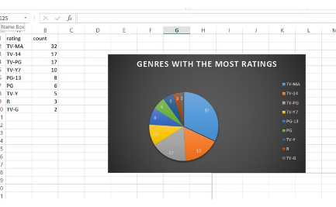
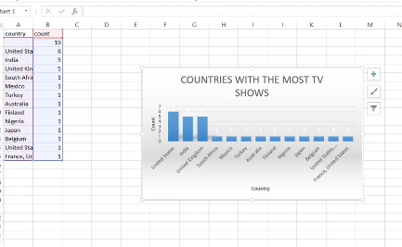
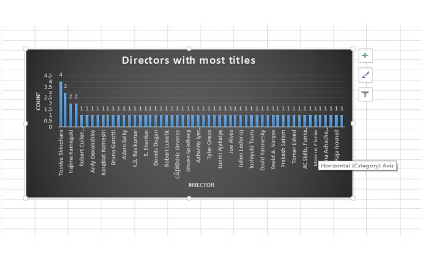
Visualizing the Data: Explaining the Charts
Genres with the most ratings
Countries with the most TV shows
Directors with most titles
Leading the chart we have TV-MA, TV-14 and TV-PG with ratings 32, 17 and 17
United States tops the list with 6, followed by India and United Kingdom with 5 each
Toshiya tops the list with four titles, followed by Masahiko with three and Haijame with two.

Slide 10

Summarizing the Project
The project involved analyzing the Netflix titles data set and uncovering interesting patterns.
We discovered that the most common rating is TV-MA, followed by Toshiya Shinoyara having the most titles.
We then visualized these findings and explored further with SQL queries.

